Slide 1
Voice Emotion Analysis
Ranjan Raut

Slide 2
About Problem
Sentiment Analysis until now

Slide 3
About Problem
I never said he ate your chocolate

Slide 4
Solution
Let’s teach machine the art of Voice Modulation

Slide 5
Dataset
Ryerson Audio-Visual Database of Emotional Speech and Song (RAVDESS)
2206 audio speech files of 3 sec, 24 actors
2 statements for training
Kids are talking by the door
Dogs are sitting by the door
Emotions
Neutral | Angry
Calm | Fearful
Happy | Disgust
Sad | Surprised

Slide 6
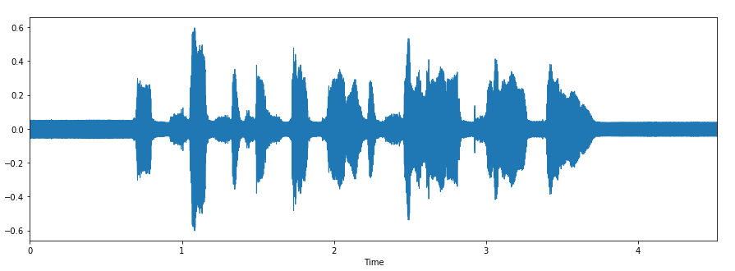
Mel-Frequency Cepstral Coefficients (MFCCs)
Waveform for Audio Clip

Slide 7
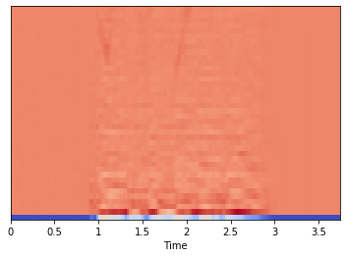
Mel-Frequency Cepstral Coefficients (MFCCs)
Spectrogram of MFCC values

Slide 8
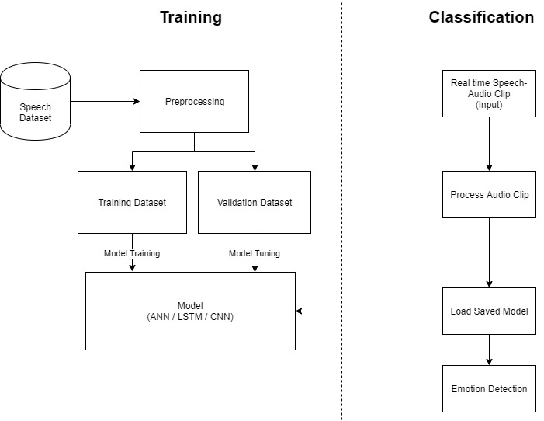
System Architecture

Slide 9
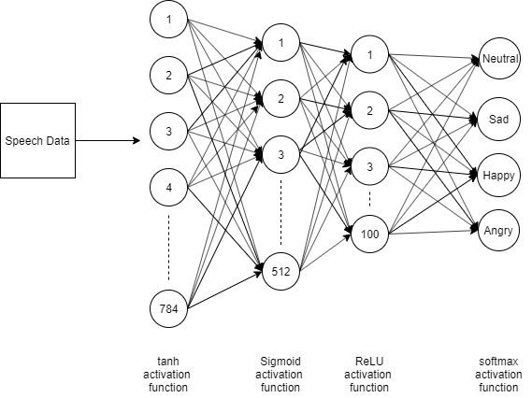
First Experiment : ANN

Slide 10
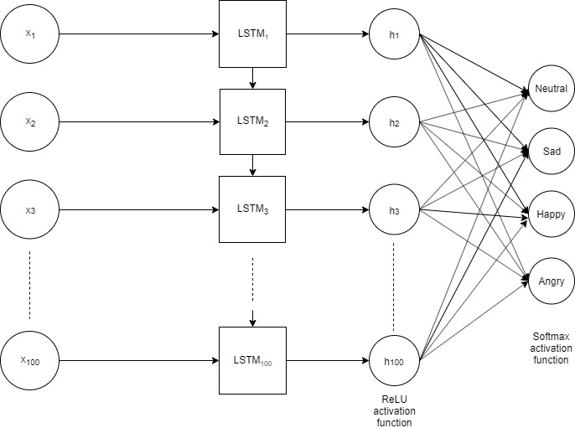
Second Experiment : LSTM

Slide 11
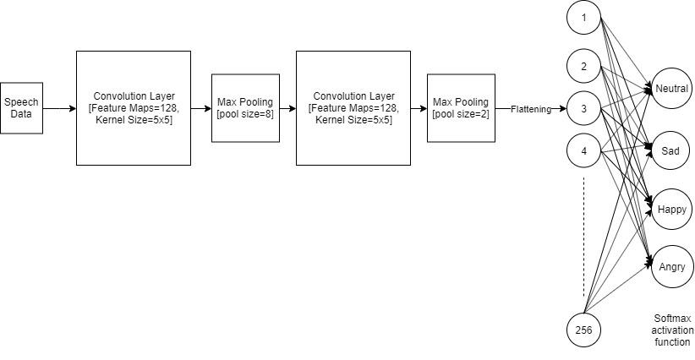
Third Experiment : CNN

Slide 12
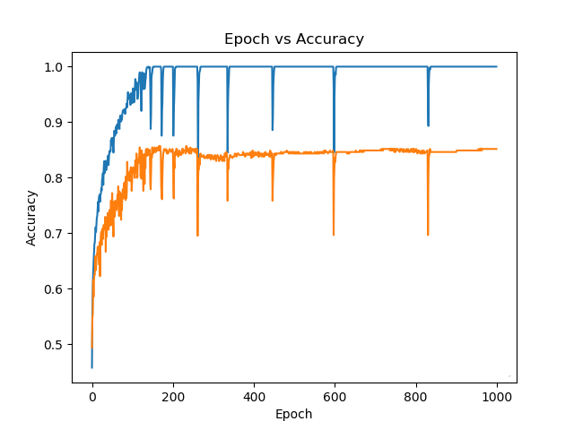
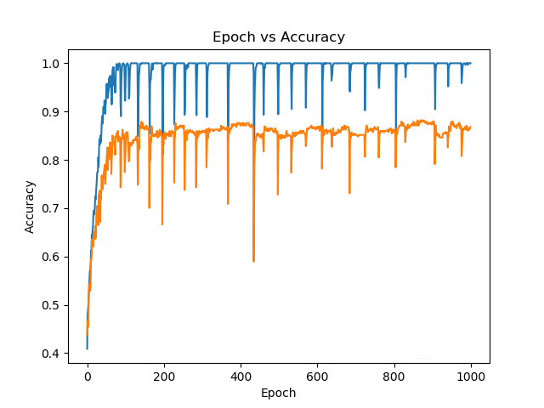
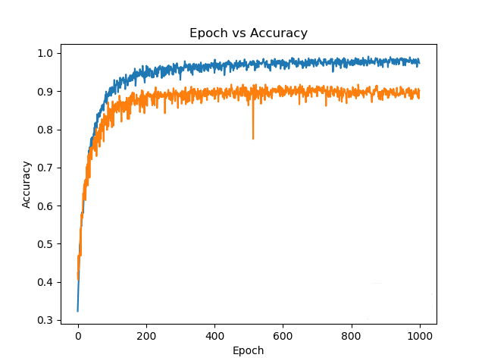
Results
Training Data
Validation Data
ANN
LSTM
CNN

Slide 13
Classification Report
precision recall f1-score support Neutral 0.92 0.98 0.95 198 Sad 0.91 0.84 0.88 141 Happy 0.84 0.79 0.82 134 Angry 0.92 0.93 0.92 255 accuracy 0.90 728 macro avg 0.89 0.89 0.89 728 weighted avg 0.90 0.90 0.90 728

Slide 14
Normalized Confusion Matrix
 | Neutral | Sad | Happy | Angry
Neutral | 0.98 | 0.01 | 0.01 | 0.0
Sad | 0.03 | 0.84 | 0.04 | 0.09
Happy | 0.06 | 0.07 | 0.79 | 0.07
Angry | 0.02 | 0.0 | 0.05 | 0.93

Slide 15
Limitations and Future Work
Limitations
Audio Length
Accent
Future Work
Furthermore classification based on gender and languages
Combination of sentiment recognized from Voice as well as Text

Slide 16
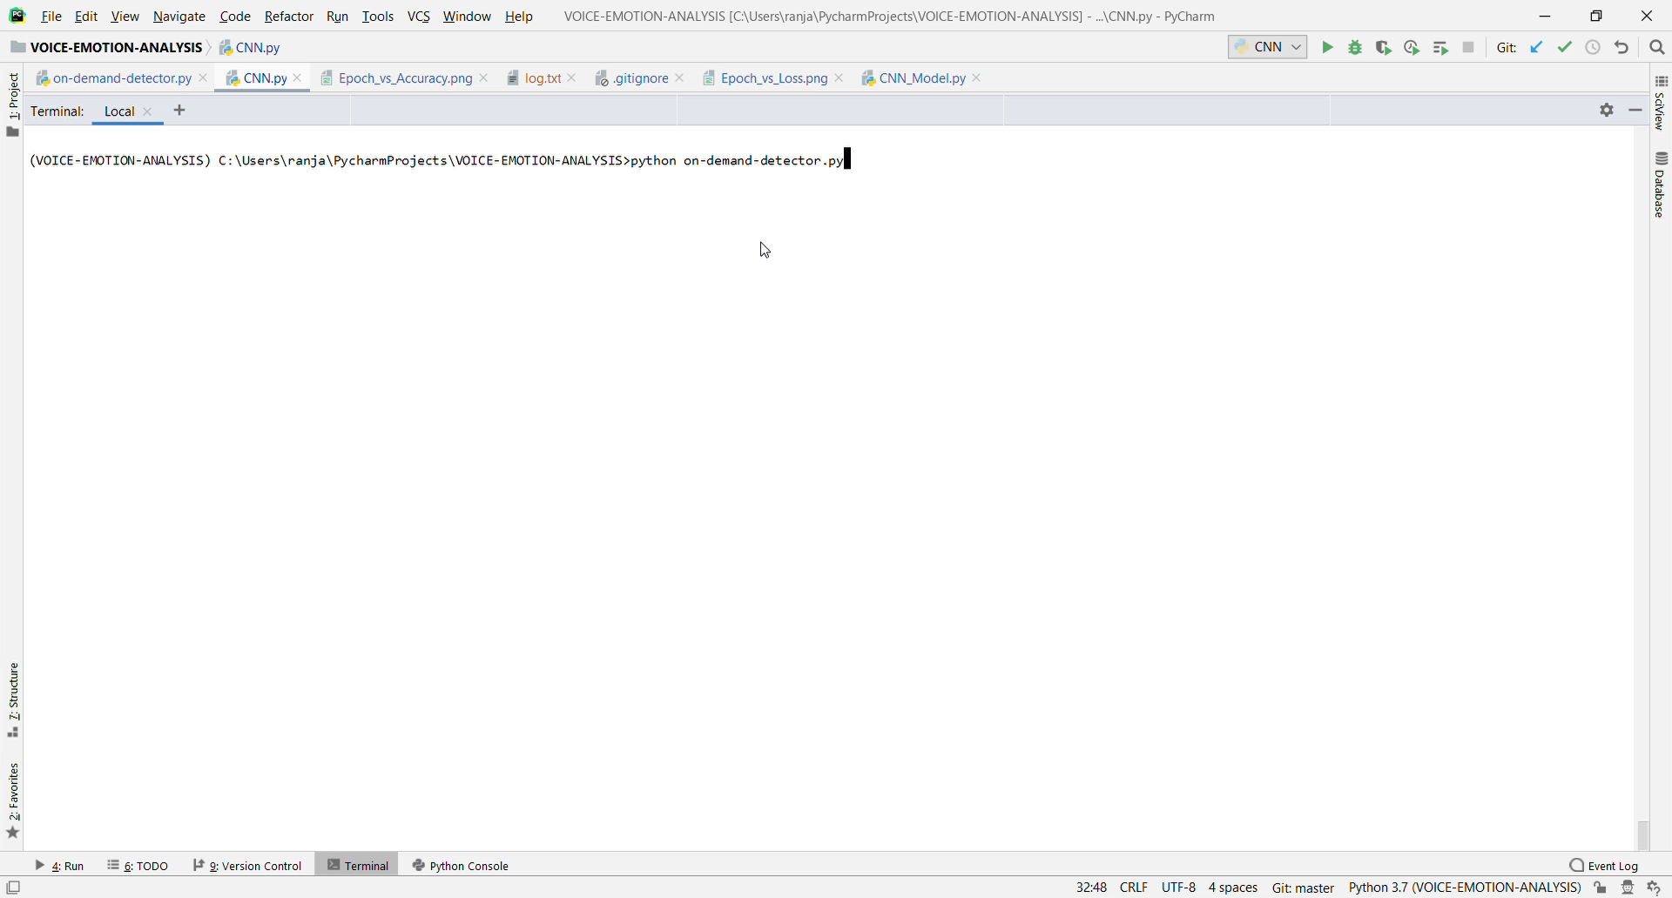
Demo

Slide 17


